Slide 1
DATA SCIENCE PROJECT
House Price Prediction
Submitted By
Nidhi Charde

Slide 2
CONTENTS OF Project
Introduction
Type of Problem.
Analytical Problem Thinking.
Data Pre-Processing
Input-Output logic Relationships
Assumptions.
Model Development.
Visualizations.
Hyperparameter Tuning.
Interpretation of Results.
Conclusion.
Data Sources & Data Formats.
Hardware & Software Tools Required.
Bibliograpghy
Thank You

Slide 3
01
02
03
OUR PROCESS
PROBLEM & SOLUTIONS
MODEL BUILDING
TABLE OF CONTENTS
Regression
Problem
Data Pre-Processing & Cleaning
Model Building & Hyper Parameter Tuning

Slide 4
Introduction
Houses are one of the necessary need of each and every person around the globe and therefore housing and real estate market is one of the markets which is one of the major contributors in the world’s economy. It is a very large market and there are various companies working in the domain. Data science comes as a very important tool to solve problems in the domain to help the companies increase their overall revenue, profits, improving their marketing strategies and focusing on changing trends in house sales and purchases. Predictive modelling, Market mix modelling, recommendation systems are some of the machine learning techniques used for achieving the business goals for housing companies. Our problem is related to one such housing company. A US-based housing company named Surprise Housing has decided to enter the Australian market. The company uses data analytics to purchase houses at a price below their actual values and flip them at a higher price. For the same purpose, the company has collected a data set from the sale of houses in Australia. The data is provided in the CSV file below. The company is looking at prospective properties to buy houses to enter the market. You are required to build a model using Machine Learning in order to predict the actual value of the prospective properties and decide whether to invest in them or not.
Business Goal: You are required to model the price of houses with the available independent variables. This model will then be used by the management to understand how exactly the prices vary with the variables. They can accordingly manipulate the strategy of the firm and concentrate on areas that will yield high returns. Further, the model will be a good way for the management to understand the pricing dynamics of a new market.

Slide 5
For this company wants to know: • Which Variables are important to predict the price of variable? • How do these variables describe the price of the house?
Problem Statement

Slide 6
EDA
EDA is the approach to analysing data sets to summarize their main characteristics.
Many Libraries are available to perform EDA like pandas ,seaborn and matplotlib.
Steps in EDA: -
Variable Identification
Univariate Analysis
Bivariate Analysis
Handling Missing Values
Handling Outliers

Slide 7
Visualization
We will be using Libraries such as Seaborn, matplotlib, plotly. At first we will be importing the libraries so that we can use visualizations for our Dataset. We will perform Univariate analysis, Bivariate Analysis and Multivariate Analysis to get insight of the PFA Housing Project Dataset. Outliers and skewness is also being detected by visualization with the help of boxplots.

Slide 8
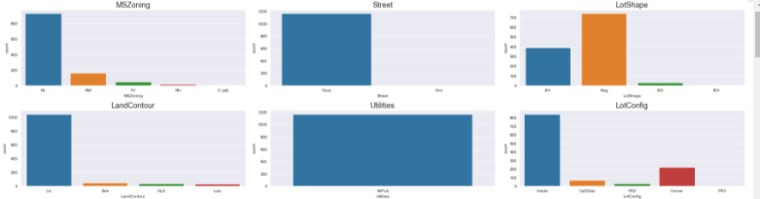
Visualization: - Univariant Analysis

Slide 9
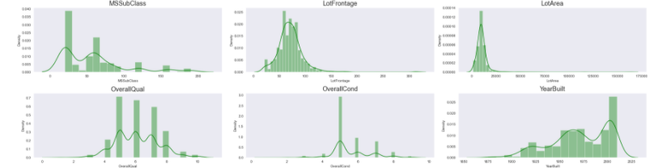

Slide 10
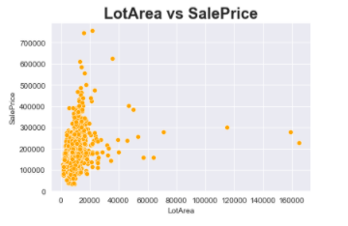
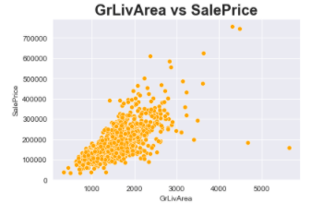
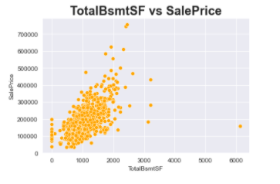
Visualisation: - Bi Variate Analysis

Slide 11
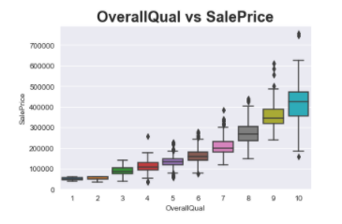
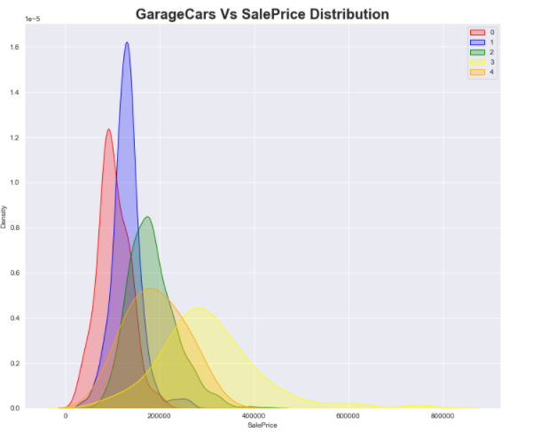
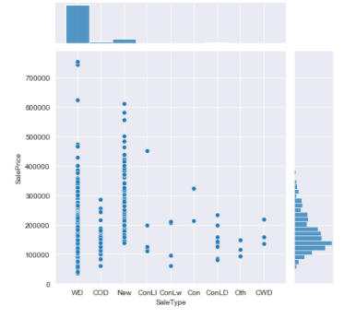
Visualisation: - Bi Variate Analysis

Slide 12
Visualisation: - Bi Variate Analysis

Slide 13
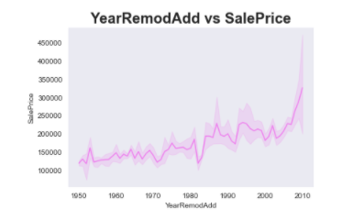
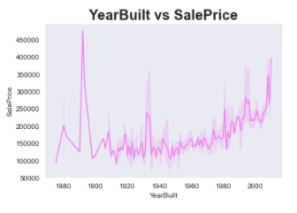
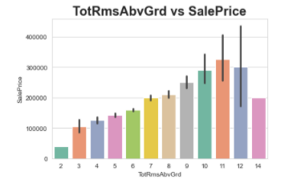
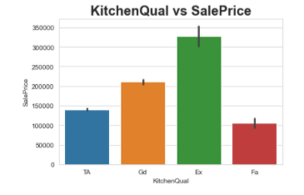
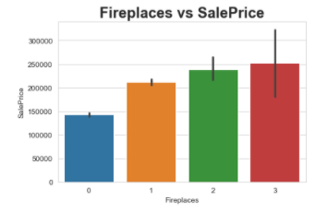

Slide 14
Data Pre-processing
Data pre-processing is a data mining technique that involves transforming raw data into an understandable format. Real-world data is often incomplete, inconsistent, lacking in certain behaviours or trends, and is likely to contain many errors.
Data pre-processing is a proven method of resolving such issues. Data pre-processing prepares raw data for further processing. Data pre-processing is used in database-driven applications such as customer relationship management and rule-based applications (like neural networks).
In Machine Learning (ML) processes, data pre-processing is critical to encode the dataset in a form that could be interpreted and parsed by the algorithm.

Slide 15
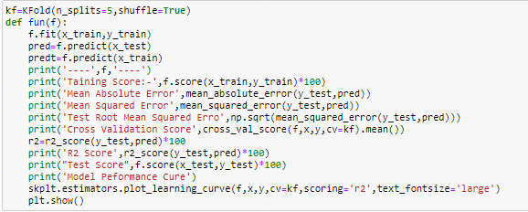
Splitting Data Into Train Test
Here, I create this function for apply on the different different models.
I used Matrices like Mean Absolute Error, Root Mean Squared Error and R2 Scores
I also used KFold Cross validation methods to check overfitting and underfittings
From Skplt I used performance curve for evaluation.

Slide 16
Dashboard Of The Model
From this we can see that some model is Overfitting and Some are Underfitting but
I get the Best result in LGBM Regressor which having less RMSE and CV is good.

Slide 17
Assumption
As from the Problem statement which states that we have to build a model which will predict average price. Since the target variable is continuous we can readily presume that it is a Regression Problem for which we will be using Regressor algorithms to build our model from the dataset given.
Secondly as we know Data is very expensive I tried those methods for Data cleaning which doesn’t require removal of bulk of Data.
Like for example I did not use IQR method for Outliers as it would have erased huge amounts of Data. Instead I used Median method for Outlier treatment.
Lastly I will be using RandomSearch CV for hyper parameter tuning as it uses least amount of memory and processing power to run the algorithms as compared to that of GridSearch CV.

Slide 18
So now we have established what is Data pre-processing, I will let know all the steps I took to clean the Data before proceeding:
- Firstly I checked for Null Values, there were so we will treat them later.
- Secondly I checked for any Nan values in the dataset which I found, so I filled all the Nan values with zero rather than removing it.
- Thirdly I found outliers and skewness in the Dataset which I dealt with by using median of the columns and replacing it with respective medians.
- I also found some ‘-‘sign in the dataset. Which I removed with the help of replace statement.

Slide 19
RESOURCES
Software Tool Used :
Hardware Tools Used:
Device name LAPTOP-H1THMP6O
Processor AMD Ryzen 5 4600H with Radeon Graphics 3.00 GHz
Installed RAM 16.0 GB (15.4 GB usable)
Device ID 2689A156-E19A-410D-AB85-F077463A8E13
System type 64-bit operating system, x64-based processor
Pen and touch No pen or touch input is available for this display
512gb SSD
Anaconda for calling JN.
Jupiter Notebook for Code handling and Visualization.
Python Shell for installing some libraries.
Excel for calling .CSV(comma separated values)
Microsoft Word for documentation.
Word to pdf Converter Online.(WBA)
Microsoft Power Point Presentation

Slide 20
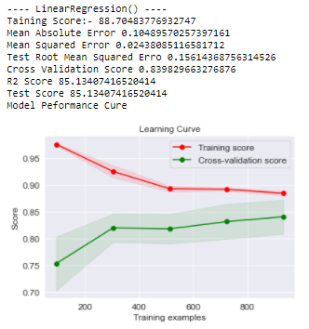
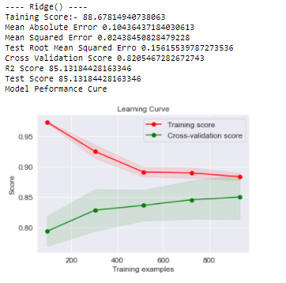
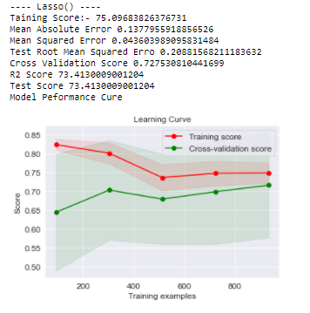
Performance Curve and Metrics Of Different Model

Slide 21
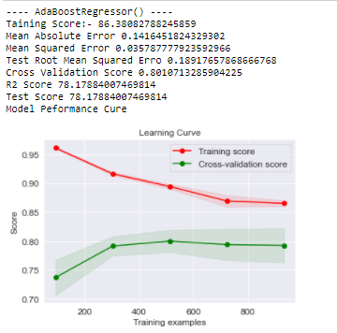
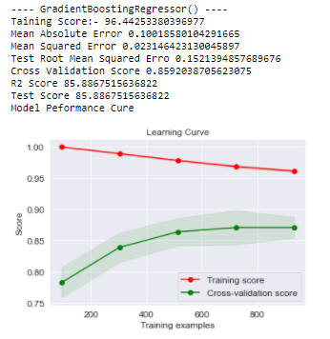
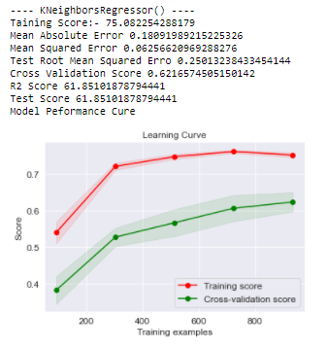
Performance Curve and Metrics Of Different Model

Slide 22
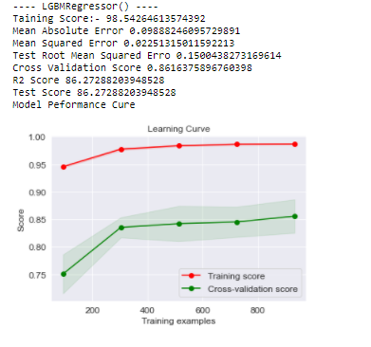
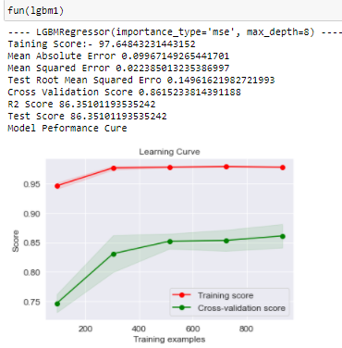
Finalized Model
Before Hyper Tunning
After Hyper Tunning

Slide 23
Conclusion
As this model is based on Australian Market only this model you can not apply globally.
From this model I learn many things and for this model Tree base algorithm is mostly use.
Here dataset is small so I used KFold Value 5 but if for big dataset KFold Value will be 10.
Here Data set having also many missing values and for future scope if I provide geological data like longitude and Latitude than I can visualize on Map so it will be more easy to under stand and having more impact.

Slide 24
Thank You

